Slide 1
János Dani
GitHub: /danijanos
Instagram: /dan1jan1
CEU / OSA helpdesk
Notes:
Hello everyone, let me introduce myself, my name is János Dani and I am currently working at OSA as a helpdesk assistant
and besides that, I am involved in the project of digitizing OSA’s analogue audiovisual materials.

Slide 2
Using Airflow as an Orchestrator for microservices
Archiving at OSA
Notes:
My presentation title sounds fancy and a bit mysterious but basically it means that
we were defined archival jobs (microservices) in an ordered manner and used Airflow as a tool to help us execute them in an organized, supervised way.
Although I'm not an expert but I would like to show Airflow to this community
and after my brief introduction my colleague Jozsef Bone will show you how we use this tool in details.

Slide 3
What are microservices?
Architectural style
Structures an application as a collection of services
Highly maintainable and testable
Loosely coupled
Independently deployable
Communication through transactions
Could be scaled separately and independently
Notes:
As Zsuzsa previously mentioned, based on Dave Rice recommendations we defined archival processes as microserviceses.
I’m sure most of you in the audience knows what microservices are so I just want to highlighting some core ideas behind the concept.
So microservices are defined as an architectural style where your system or application build as structures of service collections.
This services are loosely coupled, independently deployable units.
The consistency and communication between components is done through transactions.
Components could be scaled separately and independently.

Slide 4
Workflow tools
There is quite a lot...
They are for various purposes
Why is one better or favourable than the other?
Notes:
So at the time we were looking for a tool which can orchestrate or supervise our services.
And we were able to find quite a lot on the internet... (click!)
There are the well known ones like Luigi by Spotify
But the main reason we were choosing Airflow besides other workflow management softwares is because: (next slide)

Slide 5
The process of choosing
Uses workflow as a broader sense
Good (visual) monitoring
Alerts
Email notification
Charts
Error checking
Has a good documentation / community behind
[Open source]
Notes:
Airflow uses workflow as a broader sense.
Has a good visual monitoring capability using a web UI
where you got visual feedback from what is going with your tasks, what are they doing, and in what state they are currently in.
Airflow is capable of sending alerts in form of email notifications.
Could show useful charts - I will show some of them later
Has a good documentation and community behind.
(click!)
At the moment they have 991 contributors.
And at last but not least it is open source.

Slide 6
About Airflow
Started at Airbnb in October 2014
Written in Python
Becoming an Apache Incubator project in March 2016
Top-Level Software Foundation project in January 2019.
source:
https://en.wikipedia.org/wiki/Apache_Airflow
https://airflow.apache.org/
Notes:
A little bit of Airflow’s history:
It started at Airbnb in October two thousand and fourteen
Written in Python.
Becoming an Apache Incubator project in March two thousand and sixteen.
And in this year it became a Top-Level Software Foundation project at Apache.

Slide 7
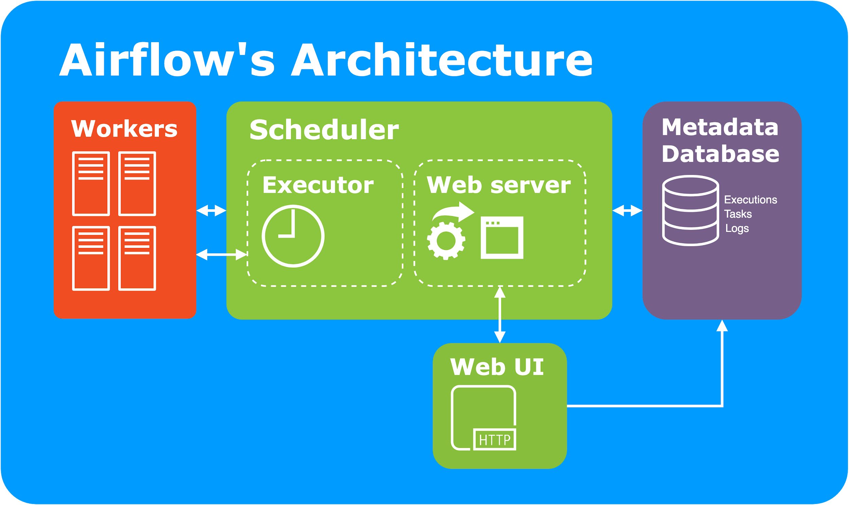
Notes:
This is the architecture of it
At the center you can see the scheduler which includes the executor - I will get back to this later - and a webserver.
The scheduler is like an alarm clock. It schedules executions of tasks.
The database stores information about the execution statuses and dates , tasks and logs.
The workers are basically nodes or machines, they are communicating with the scheduler.
The Web UI is where you can control your operations, trigger workflows, you can see charts, read logs…etc
Basically, most of the operations you need to do, you can do it through the UI.

Slide 8
The scheduler
Executes (triggers) tasks on an array of workers
Monitors all tasks
Executor types:
Sequential executor
Local
Celery (to scale tasks on different worker nodes)
source:
https://airflow.apache.org/docs/stable/scheduler.html
Notes:
The scheduler executes and triggers the task instances whose dependencies have been met on an array of workers.
Spins up a subprocess, which monitors and stays in sync with a folder for all workflow objects and periodically (every minute or so) collects them and inspects active tasks to see whether they can be triggered or not.
The scheduler starts an instance of the executor specified in your airflow config file.
An executor could be a:
Local or sequential executor - this should be chosen when tasks should be executed as subprocesses.
or
Celery (Dask, Mesos) - when tasks should executed remotely

Slide 9
Basic conceptual building blocks
Dags (Pipelines)
Operators
Tasks
task 1
task 2
task m+2
start
task 3
task m+1
task m+3
end
.
.
.
.
.
.
task m
task n
Notes:
Now Let me talk about the conceptual building blocks or core ideas as how airflow calls them.
Airflow uses directed acyclic graphs (DAGs) to describe workflows.
They can be written in one Python file
DAGs can be run either on a defined schedule (hourly or daily) or on external event triggers.
We currently triggering our DAG with external mouse click event by hand. (Jozsef will tell you more details about this later)
...
Operators provide that a single pipeline might contain bash, Python or SQL operations.
So basically we can do anything what Python could which is quite a lot of thing
And with dependencies specified between them, you can control or restrict the flow of your data processing.

Slide 10
Dag
default_args = {
'owner': 'airflow',
'depends_on_past': False,
'start_date': datetime(2018, 1, 1),
'email': ['bonej@ceu.edu', 'danij@ceu.edu'],
'email_on_failure': True,
'email_on_retry': False,
'retries': 1,
'retry_delay': timedelta(minutes=5)
}
Holds a series of tasks connected with dependencies
Made for avoiding cyclical dependencies between tasks
Dags are identified by their IDs
# DAGS
osa_av_workflow = DAG(
dag_id='osa-av-workflow',
description='Main DAG for the AV preservation workflow',
default_args=default_args,
schedule_interval=None,
catchup=False)
Notes:
If a task has cyclical dependency it will never finish.
That is why Airflow uses a concept called DAG for all workflow definitions.
DAG’s define the logic of your workflow and the shape of your graph.
A DAG isn't concerned with what its constituent tasks do.
Its job is to make sure that whatever they do it happens at the right time, or in the right order, or with the right handling of any unexpected issues.
They can be played or paused but they have a start date.
Every scheduled period between the start date and now the scheduler will backfill past executions.
So be careful - it runs as many times as it should have between these dates!
(click!)
If you don’t want that behaviour, you should set the catch up parameter to false.

Slide 11
Operators
create_master_checksums = PythonOperator(
task_id='create_master_checksums',
python_callable=create_checksums,
dag=osa_av_workflow,
op_kwargs={
'directory': 'Preservation',
'file_extension': MASTER_FILE_EXTENSION
})
BashOperator - executes a bash command
PythonOperator - calls a Python function
EmailOperator - sends an email
SimpleHttpOperator - sends an HTTP request
BranchOperator
…
Write your our own operators!
source: https://airflow.apache.org/concepts.html#operators
Notes:
Operators are associated to dags.
So Operators are only loaded if they are assigned to a DAG.
They are loosely coupled functions
Airflow provides operators for many common tasks for example:
BashOperator allows you to run a bash command or script
For calling a python function you can use a PythonOperator
You can send an email with an EmailOperator, an HTTP request with SimpleHttpOperator, or executing an SQL command with MySqlOperator
(click!)
There is also a BranchOperator for branching to decide which path or way should follow your execution flow.
Operators are subclasses of the BaseOperator so you can write your own as well.
They are basically a python class with an execute method...

Slide 12
Tasks
op1.dag = dag
op1.set_downstream(op2)
# is the same as:
dag >> op1 >> op2
op1 >> op2
# is the same as:
op1.set_downstream(op2)
op2 << op1
# is the same as:
op2.set_upstream(op1)
Tasks are instantiated operators.
Connected with dependencies
Can be parallelized
Notes:
Tasks are instantiated operators.
A parameterized task becomes a node in a DAG.
Each task has to finish it’s execution before its downstream task starts running.
But if they are independent from each other they can run in the same time, that is how airflow introduces parallelization.
In the right side you can see how dag assignment and dependencies can be defined.

Slide 13
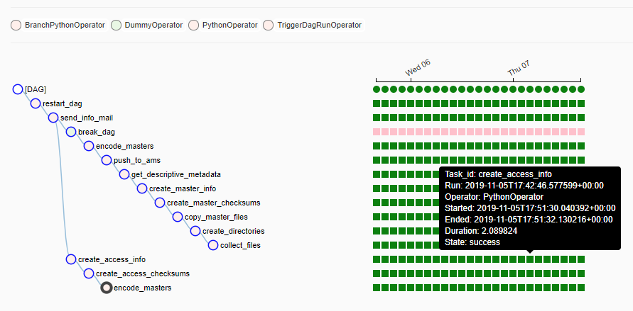
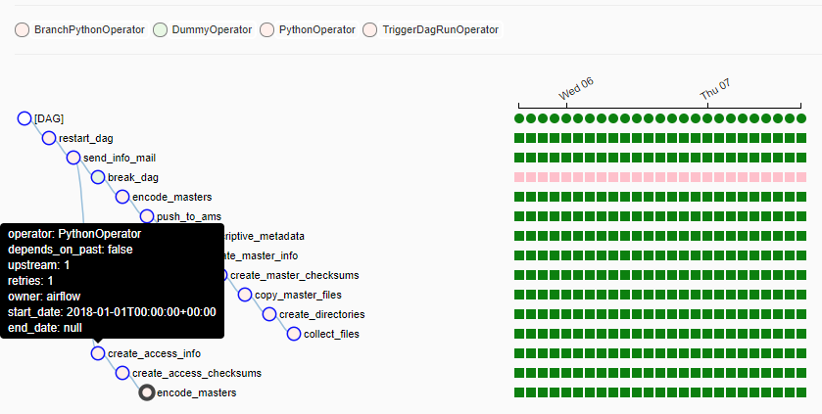
Statuses
success
queued
running
no status
failed
skipped
retry
Notes:
Task instances also have states, which could be “running”, “success”, “failed”, “skipped”, “up for retry”, etc.
A task goes through various stages from start to completion.
(click!)
In the Airflow Web UI’s graph and tree views, these stages are displayed by a color representing each stage.

Slide 14
Airflow Web UI - Gantt chart
Notes:
The web UI also provides useful charts
For example in this Gantt chart you can see how long a task was running, lets you analyse task duration and overlaps.

Slide 15
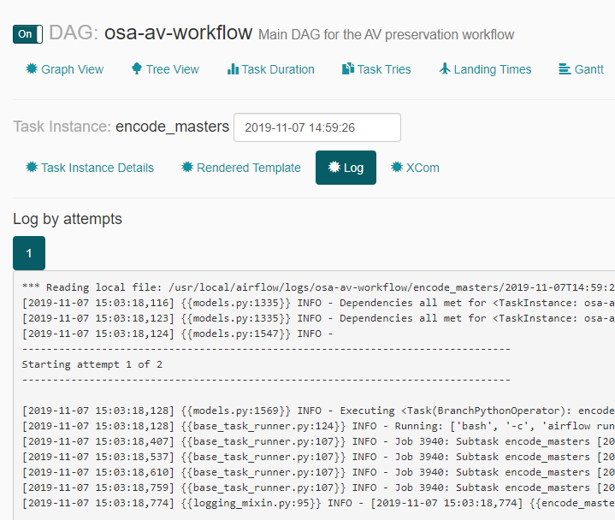
Airflow Web UI - Logs
Notes:
Or you can view logs for information about tasks or events
(click!)
searching for errors…

Slide 16
Links
https://airflow.apache.org/
https://hub.docker.com/r/apache/airflow
http://michal.karzynski.pl/blog/2017/03/19/developing-workflows-with-apache-airflow/
Notes:
Airflow is so much more but I run out of time, so
In this point I would like to thank you all for your attention and let me pass the microphone to my colleague Jozsef Bone who will show you more details about our use of Airflow during digital preservation.
And these are some useful links.
Thank you very much again!

